Slide 1
%Team_name%
Project by boris kanev and martin sevov

Slide 2

Who we are?
We are:
1. Boris Kanev – Developer, Team manager
2. Martin Sevov – Developer

Slide 3
What is the Goal of our program
We wanted to make a few games that use strings.
Future Goals
We have made a Microsoft Form with the goal to collect user information about bugs, language errors, ideas.

Slide 4

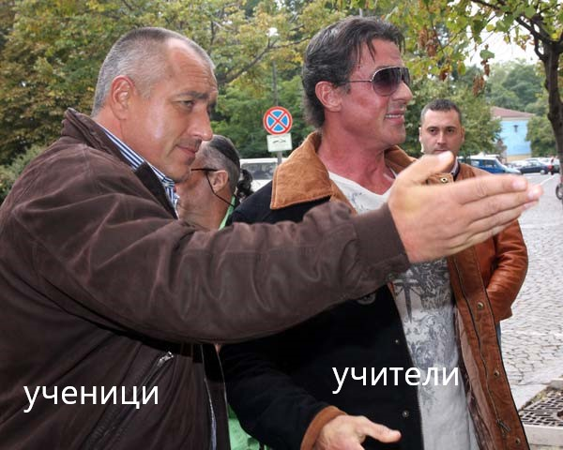


What we used to made the program?
We used Visual Studio to work on the program.
We used GitHub to share code.
We used Discord for communication.

Slide 5
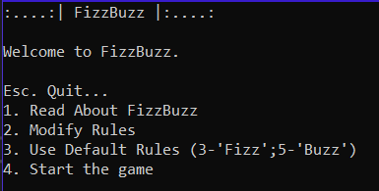
Fizz buzz
Fizz buzz is a group word game for children to teach them about division. Players take turns to count incrementally, replacing any number divisible by three with the word 'fizz', and any number divisible by five with the word 'buzz'.

Slide 6

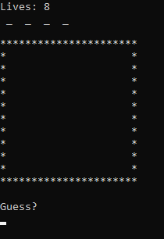
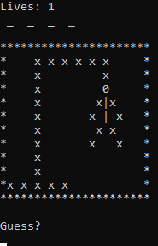
Hang Man
Hang man is a word game where the player guesses a word. The player guesses a word or a letter and if it is correct you will get points. For each correct letter you get 10 points.

Slide 7
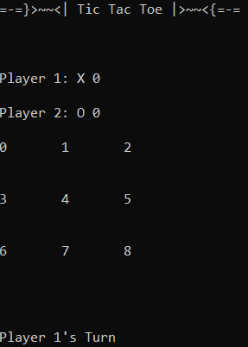
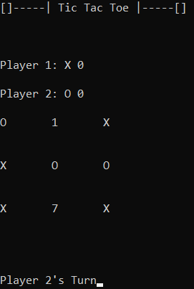
tic tac toe
'Tic-tac-toe' (American English), 'noughts and crosses' (British English), or 'Xs and Os' is a paper-and-pencil game for two players, X and O, who take turns marking the spaces in a 3×3 grid. The player who succeeds in placing three of their marks in a horizontal, vertical, or diagonal row is the winner.

Slide 8

Code time

Slide 9

Questions Time

Slide 10

thanks for your attention

